Slide 1
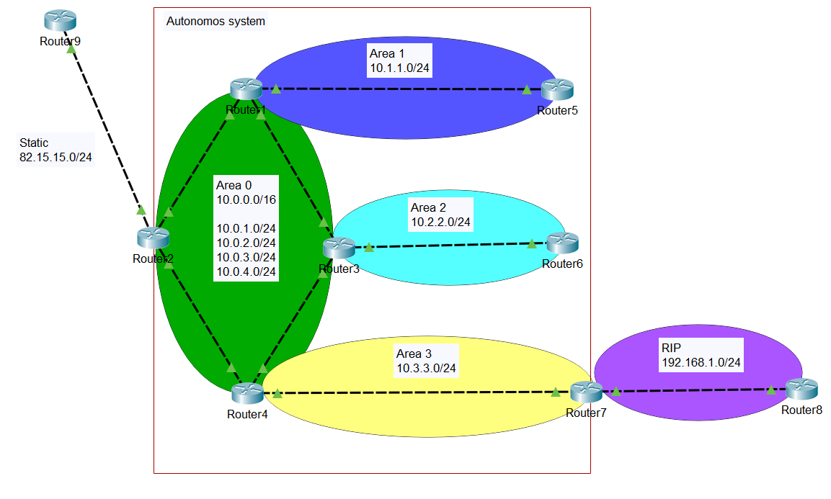
OSPF advanced
Module 2
SoftUni Team
Technical Trainers
Software University
http://softuni.bg

Slide 2
Questions
sli.do #NetAdvanced

Slide 3
Table of Contents
Basic concepts and single area OSPF
Multi area OSPF
Connecting OSPF to external networks
LSA and area types
Demonstration

Slide 4
Basic concepts and single area OSPF

Slide 5
OSPF advantages
Fast convergence with triggered updates
Hierarchical structure (areas)
VLSM support (classless protocol)
Efficient communication with neighbors
Uses intelligent metric (cost)
Open standard

Slide 6
OSPF disadvantages
Requires more RAM and CPU on the devices – maintains different tables (neighbor, topology, routing)
Requires good and careful design when multiple areas are needed
More complex to configure and troubleshoot

Slide 7
OSPF terms
LSA – Link state advertisement
LSDB – Link state database
Router ID
Area
ABR – Area border router
Autonomous system
ASBR – Autonomous system boundary router

Slide 8
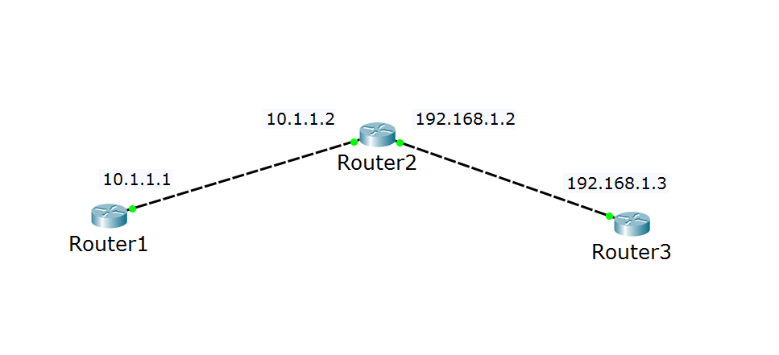
OSPF terms: router ID
I have many names (interfaces), but just call me 2.2.2.2
Hi, 2.2.2.2!
Hi, 2.2.2.2!

Slide 9
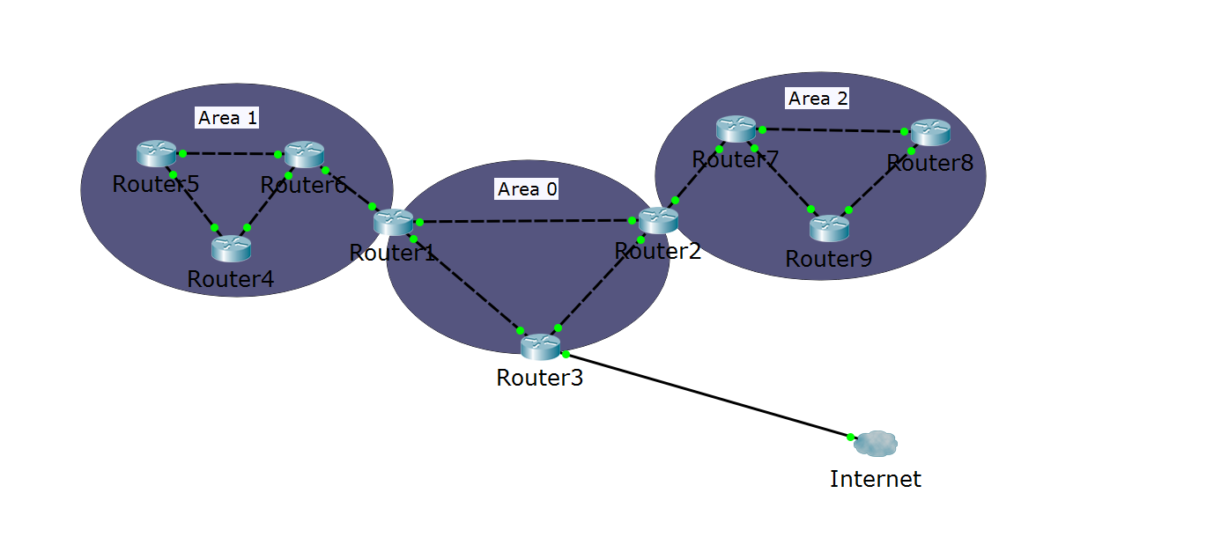
OSPF terms (2)
Autonomous system
ABR
ABR
ASBR
Area 0 = the backbone area

Slide 10
Neighbor relationships
If multiple routers are connected to a switch, we use designated router (DR) and backup designated router (BDR)
This minimizes LSA traffic
Other routers are referred to as DROTHER (DR other)
The DR and the BDR ensure that all routers receive all of the required updates

Slide 11
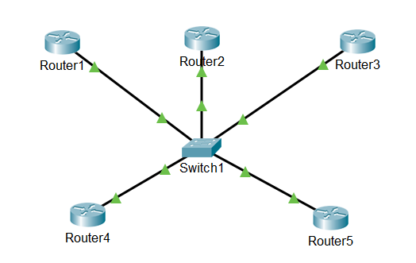
Neighbor relationships (2)
The DR, the BDR and the DROTHERs
DR
BDR
DROTHER
DROTHER
DROTHER

Slide 12
DR/BDR Election Process
The first router that is active on the link becomes the DR
The second router that is active on the link becomes the BDR
Link/interface priority is used for a re-election if the DR/BDR fails
Default priority is 1
Highest priority is elected; if a tie, the highest router ID (not IP address on the interface) is elected
A priority of 0 prevents a router from becoming a DR or BDR

Slide 13
Questions
sli.do #NetAdvanced

Slide 14
Multi area OSPF

Slide 15
Why multiple areas?
When the OSPF domain is segmented to areas:
Inter-area routes can be summarized
Router’s LSDBs are not too big
The protocol is faster
Stability and control is increased

Slide 16
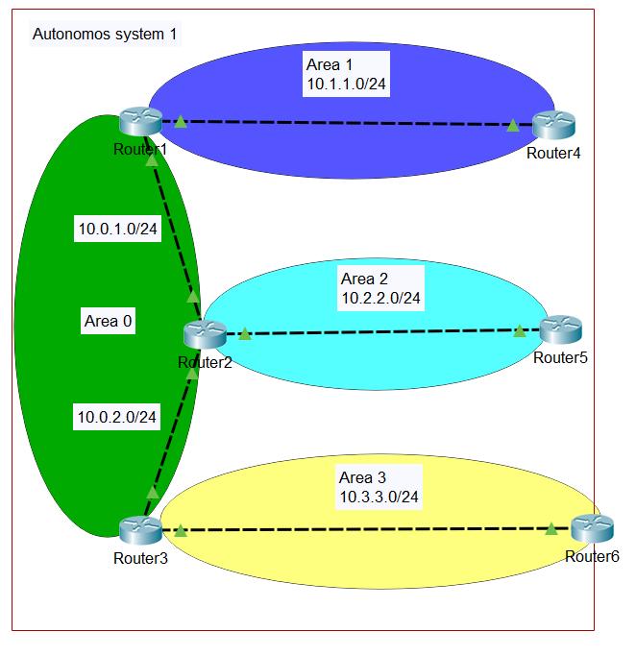
Multiple areas example
All other areas connect to Area 0 (the backbone area)
ABR routers in the example:
Router1
Router2
Router3

Slide 17
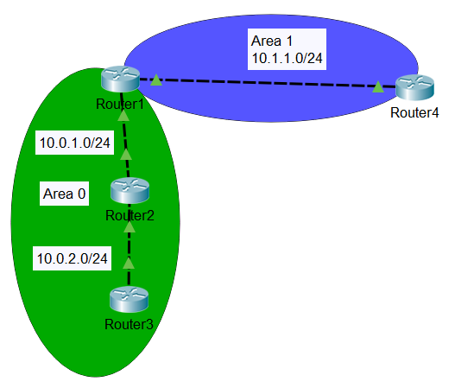
How to configure an ABR?
There is no specific command to become an ABR
When you configure a router in more than one area, it becomes ABR
Router1:
router ospf 1
network 10.0.1.0 0.0.0.255 a 0
network 10.1.1.0 0.0.0.255 a 1

Slide 18
Questions
sli.do #NetAdvanced

Slide 19
Connecting OSPF to external networks

Slide 20
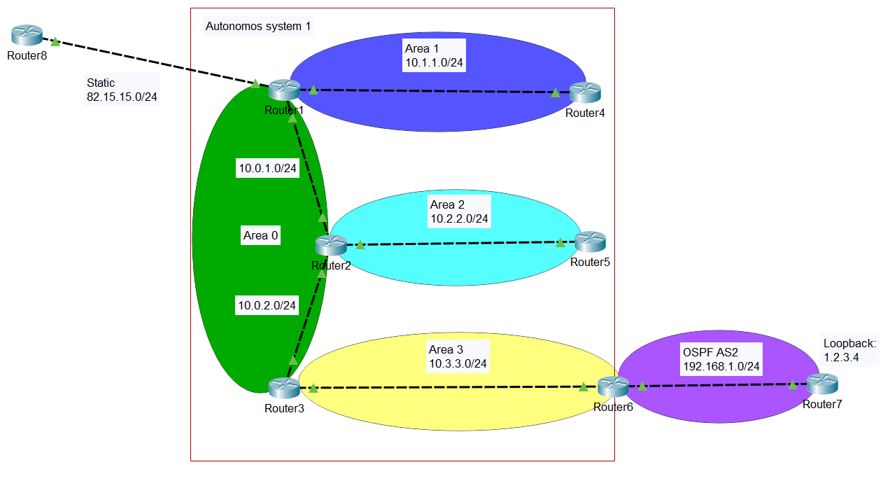
OSPF autonomous system and external networks
ASBR routers in the example:
Router1
Router6

Slide 21
Redistribute between protocols
You need to import or redistribute routes to your AS
Some options for redistribution:
redistribute RIP
redistribute ospf [process_id]
redistribute static
redistribute connected

Slide 22
Questions
sli.do #NetAdvanced

Slide 23
LSA and area types

Slide 24
OSPF LSA types
LSA type 1: Router
LSA type 2: Network
LSA type 3: Summary
LSA type 4: ASBR summary
LSA type 5: ASBR external
LSA type 6: Multicast OSPF
LSA type 7: Not-so-stubby area LSA

Slide 25
OSPF area types
Standard
Stub
Totally stubby
Not-so-stubby (NSSA) ☺

Slide 26
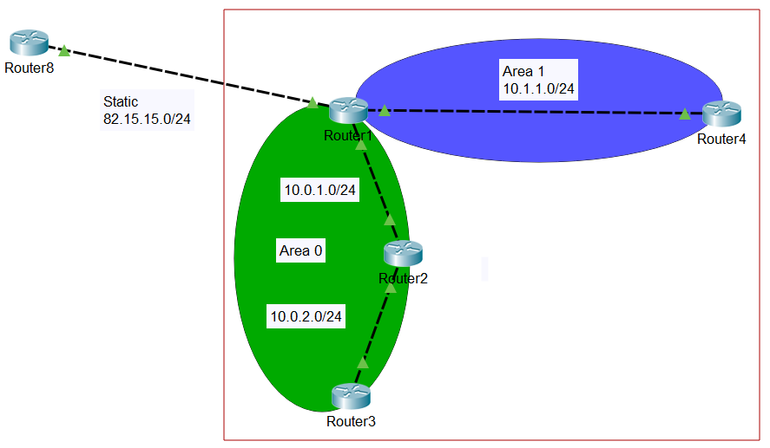
OSPF stub area
Uses LSA types 1, 2, 3 + default route (for external networks)
Blocks LSA types 4 and 5
Area 1 is stub.
Router1 injects:
Routes from area 0
Default route to externals

Slide 27
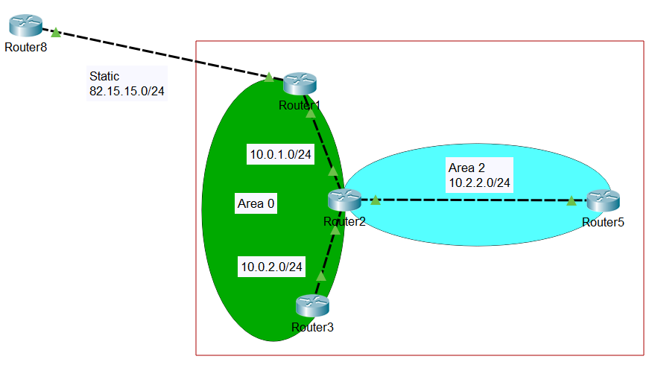
OSPF totally stubby area
Uses LSA types 1 and 2 + default route (for the other areas and external networks)
Blocks LSA types 3, 4 and 5
Area 2 is totally stubby. Router2 injects:
Default route to externals
(everything outside of Area 2)

Slide 28
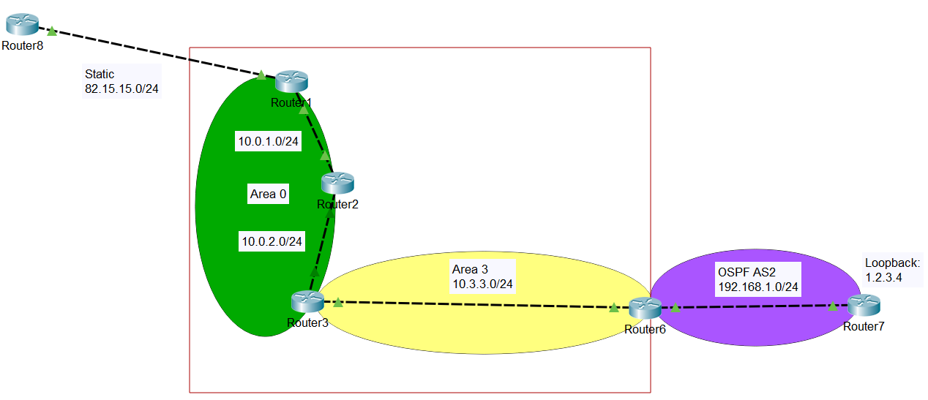
OSPF not-so-stubby area (NSSA)
Uses LSA types 1, 2, 3 and 7
Blocks LSA types 4 and 5
Area 3 is NSSA. Router6 injects:
Routes in AS2
Router3 injects:
Routes from other areas
(Route to 82.15.15.0/24 not advertised)

Slide 29
Questions
sli.do #NetAdvanced

Slide 30
Demonstration

Slide 31

Summary
Basic concepts and single area OSPF
Multi area OSPF
Connecting OSPF to external networks
LSA and area types
Demonstration
…
…
…

Slide 33






СофтУни диамантени партньори

Slide 34






СофтУни диамантени партньори

Slide 35





Trainings @ Software University (SoftUni)
Software University – High-Quality Education, Profession and Job for Software Developers
softuni.bg
Software University Foundation
http://softuni.foundation/
Software University @ Facebook
facebook.com/SoftwareUniversity
Software University Forums
forum.softuni.bg

